Slide 1

LEVERAGING LINKED DATA USING PYTHON AND SPARQL
Nabanita Roy
EuroPython2021

Slide 2
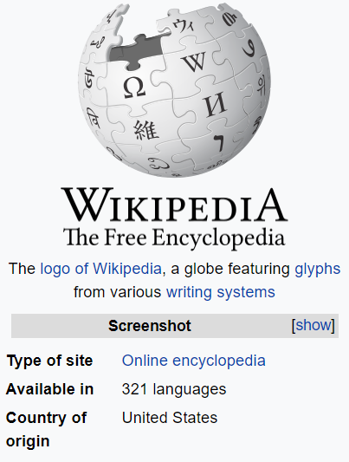
WIKIPEDIA
Multidomain
Multilingual
Freely accessible
Automatically evolving

Slide 3
HOW TO GET DATA
FROM WIKIPEDIA?
Web Scraping
Using BeautifulSoup or Wikipedia Python Library
Linked Data
Using SPARQLWrapper

Slide 4
DEMO:
WIKIPEDIA PYTHON LIBRARY
Notebook Link

Slide 5

DBpedia is a crowd-sourced community effort to extract structured information from Wikipedia and make this information available on the Web in the form of Linked Data.

Slide 6

Wikidata is a free and open knowledge base that can be read and edited by both humans and machines.

Slide 7
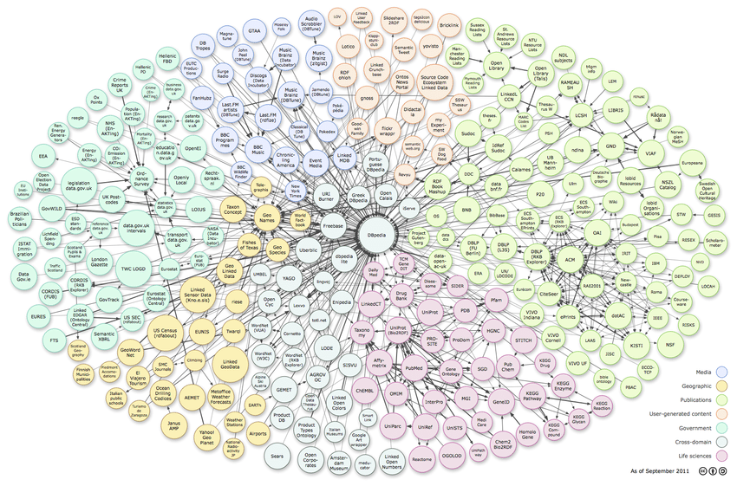
LINKED
DATA

Slide 8
A CLOSER LOOK
New York
location
PyLadies
Website link
http://www.pyladies.com/
Dublin
location
London
location
External link
type
Python Programming Language
Organization
location
Designer
type
type
type
Guido van Rossum
WAI
WWC
WIC
Notes:
Check the arrows

Slide 9
WHY
DBPEDIA
OR
WIKIDATA?
Contains knowledge from Wikipedia
Semantics of information
Easily Accessible
Python wrapper available
Data Mining for ML or NLP

Slide 10
Semantic query language to retrieve and manipulate data stored in RDF format.
S
P
A
R
Q
L
PARQL
rotocol
nd
DF
uery
anguage
Resource
Description
Framework
standard model for data interchange on the Web
Data Representation Format : Triple
subject predicate object
python type programming language
Notes:
Entity - attribute name – attribute value

Slide 11
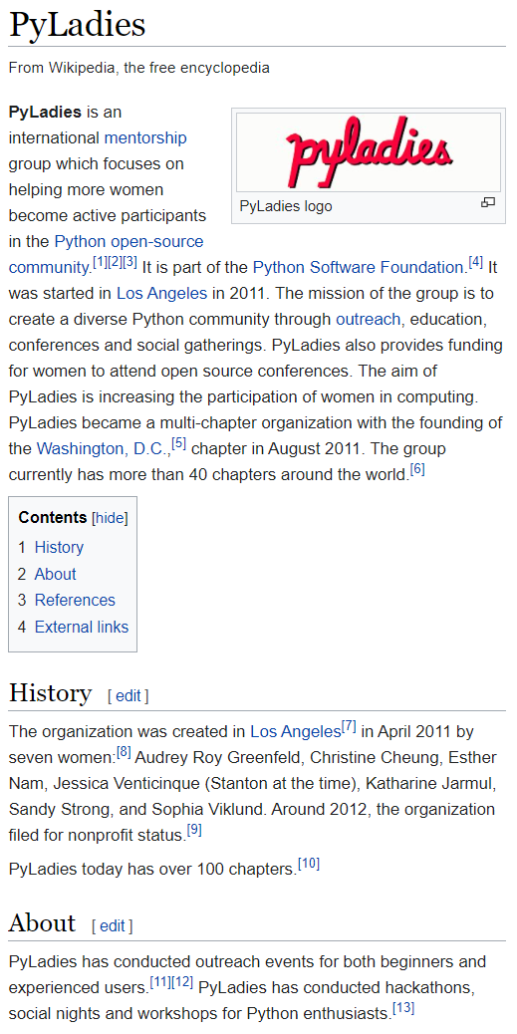
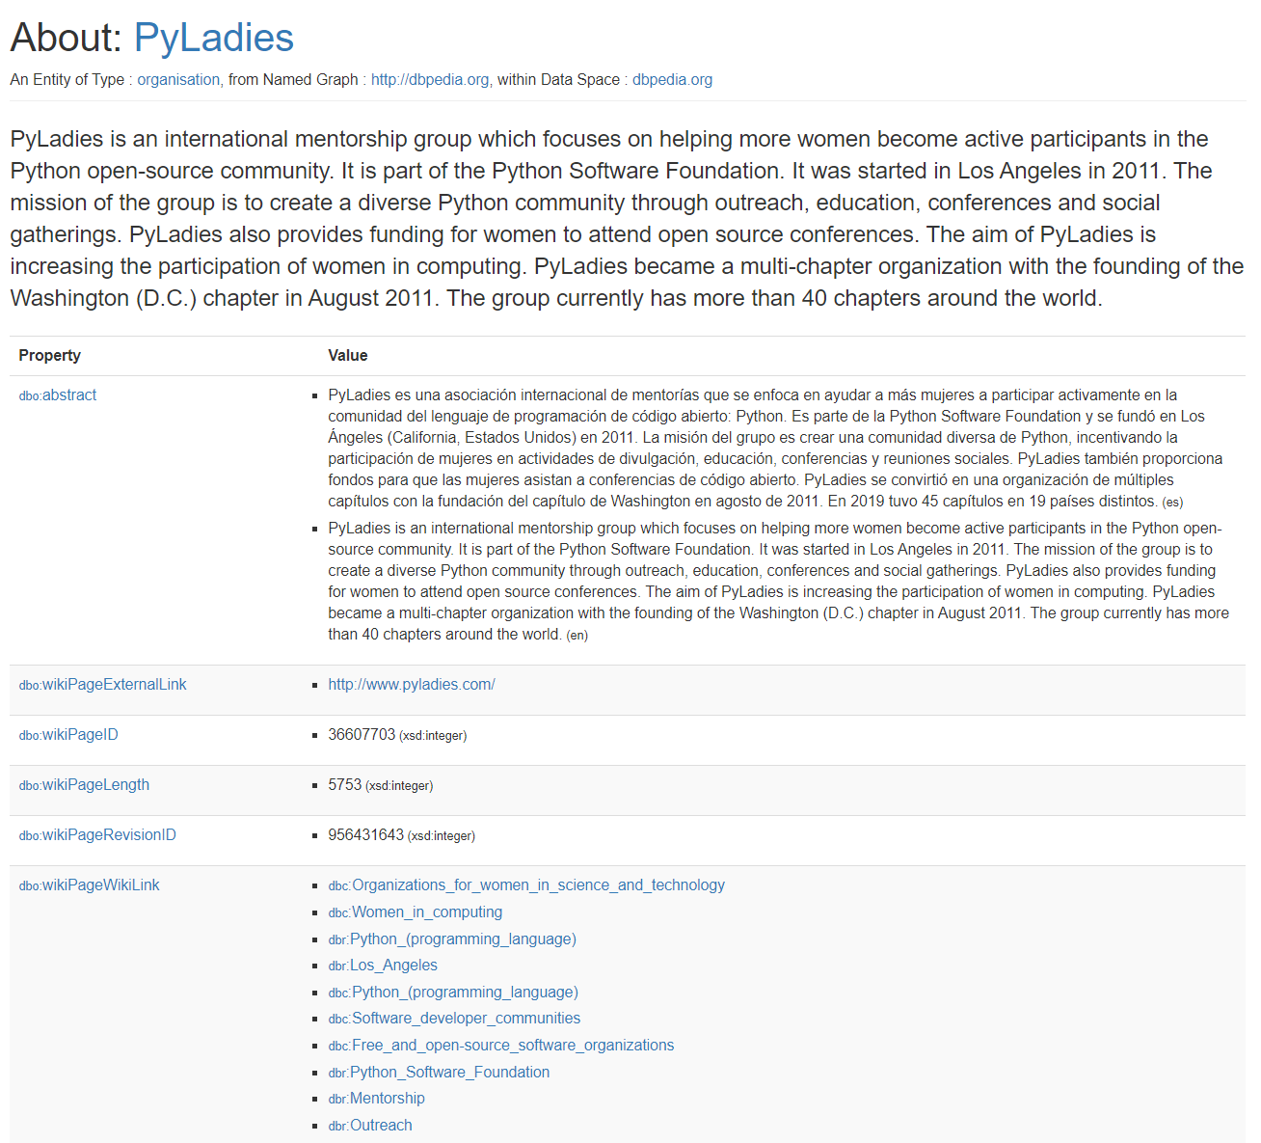
https://en.wikipedia.org/wiki/PyLadies
URI
URL
https://dbpedia.org/page/PyLadies
Vocabulary
DBO
DBR
FOAF
SKOS
Dublin Core

Slide 12
SPARQL
PREFIX foaf: <http://xmlns.com/foaf/0.1/>
PREFIX dbo: <http://dbpedia.org/ontology/>
PREFIX dbr: <http://dbpedia.org/resource/>
PREFIX dbp: <http://dbpedia.org/property/>
PREFIX ling: <http://purl.org/linguistics/gold/>
SELECT DISTINCT ?a, ?dob, ?ht, ?hpn, ?g, ?name, ?c, ?intro
WHERE
{
?a a dbo:Athlete; dbo:birthDate ?dob; dbo:height ?ht;
ling:hypernym ?hpn; foaf:gender ?g; foaf:name ?name; dbo:abstract ?intro.
OPTIONAL{?a dbo:country ?c}
FILTER(LANG(?name) = "en").
}
LIMIT 10000 OFFSET 0
PREFIX foaf: <http://xmlns.com/foaf/0.1/>
PREFIX dbo: <http://dbpedia.org/ontology/>
PREFIX dbr: <http://dbpedia.org/resource/>
PREFIX dbp: <http://dbpedia.org/property/>
SELECT DISTINCT ?a, ?dob, ?ht, ?name, ?c, ?intro
WHERE
{
?a a dbo:Athlete; dbo:birthDate ?dob; dbo:height ?ht;
foaf:name ?name; dbo:abstract ?intro.
OPTIONAL{?a dbo:country ?c}
FILTER(LANG(?name) = "en").
}
LIMIT 10000 OFFSET 0
PREFIX rdfs: <http://www.w3.org/2000/01/rdf-schema#>
SELECT
?entity, ?name
WHERE
{?entity rdfs:label ?name .}
SELECT
?subject, ?predicate, ?object WHERE
{ ?subject ?predicate ?object . }

Slide 13
Demo :
SPARQLWrapper
Notebook Link

Slide 14
Demo :
Corpora Generation using
SPARQLWrapper and Wikipedia Python Library
Notebook Link

Slide 15
THANK YOU
QA

Slide 16
REFERENCES
Introduction to Linked Data: RDF Vocabularies (slideshare.net)
http://risis.eu/wp-content/uploads/2017/03/linked-data-sparql.pdf
Constructing SPARQL Queries. From simple queries to federated… | by Angus Addlesee | Wallscope | Medium
https://www.wikidata.org/wiki/Wikidata:Main_Page

